Slide 1


JAVA PROGRAMMING FOR FLIGHT TICKET RESERVATION SYSTEM
NAME : T VITHESH REGNO :192110114

Slide 2
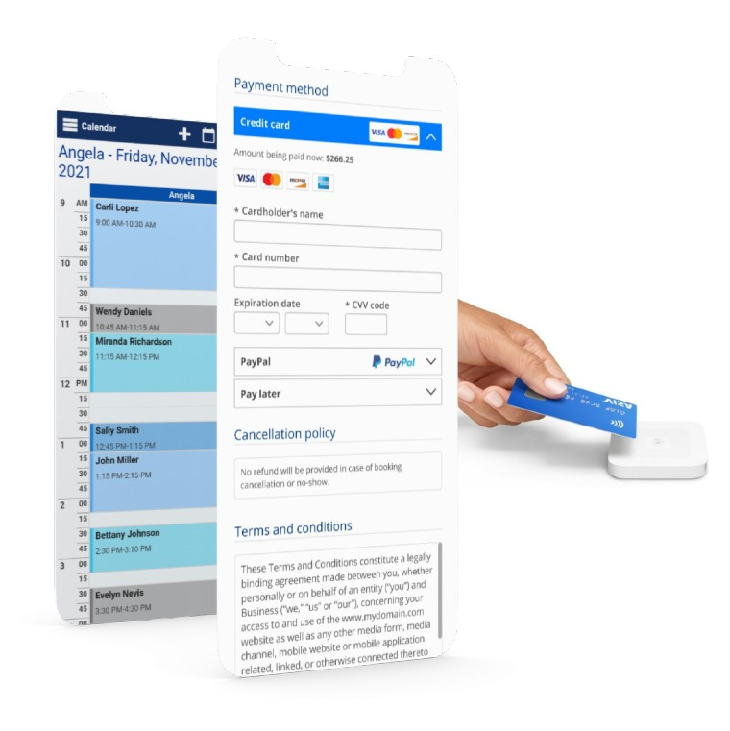
ABSTRACT
Developed a modern flight reservation system for efficient airline ticket booking.
Features comprehensive flight search functionality based on user preferences.
Real-time availability checking for accurate booking information.
Dynamic fare management system to display fares and fees transparently.
Secure payment processing with multiple payment options.
User-friendly reservation management tools for easy booking modifications.
Integration with airline databases through GDS and APIs.
Personalized user accounts for streamlined booking experience.
Proactive notifications for booking updates and flight status.
Prioritizes security and reliability to safeguard user data and transactions.

Slide 3
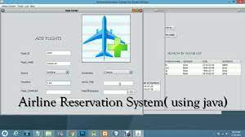
INTRODUCTION
Globalization and increased mobility drive demand for efficient air travel.
Need for robust flight reservation systems to streamline booking process.
Project aims to develop modern and sophisticated flight reservation system.
Enhances booking experience for travelers and empowers airlines/travel agencies.
Key objective: Create user-centric platform simplifying airline ticket booking.
Integrates cutting-edge technology and industry-standard interfaces.
Provides access to vast selection of flight options from various airlines worldwide.
Secure payment processing mechanisms for user peace of mind.
Aims to set new standards for excellence in air travel booking.

Slide 4
EXISTING SYSTEM
Legacy Systems: . These legacy systems, while functional, often lack the advanced features and user-centric approach of more contemporary solutions.
Global Distribution Systems (GDS): GDS platforms such as Amadeus, Sabre, and Travelport have long been used by airlines and travel agencies to distribute flight inventory and facilitate bookings.
Online Travel Agencies (OTAs): Online travel agencies like Expedia, Booking.com, and Kayak have revolutionized the way travelers book flights. These platforms provide users with the ability to search for flights, compare prices, and make bookings online.
Emerging Technologies: With advancements in technology such as artificial intelligence (AI) and blockchain, new opportunities are emerging to further enhance flight reservation systems.
Industry Collaborations: Collaboration among airlines, travel agencies, and technology providers continues to drive innovation in the flight reservation space.

Slide 5
HARDWARE / SOFTWARE
HARDWARE
Servers: High-performance servers for hosting the system.
Networking Equipment: Routers, switches, and firewalls for reliable connectivity.
Storage Solutions: HDDs or SSDs for storing databases and files.
SOFTWARE
Operating System: Linux or Windows Server for server management.
Web Server: Apache or Nginx for handling HTTP requests.
Database Management System: MySQL, PostgreSQL, or Oracle for data storage.
Programming Languages: Java, JavaScript for backend and frontend development.
Web Development Technologies: HTML, CSS, JavaScript, and frameworks like React or Angular for frontend.
Security Tools: Encryption, SSL/TLS certificates, firewalls for data protection.

Slide 6
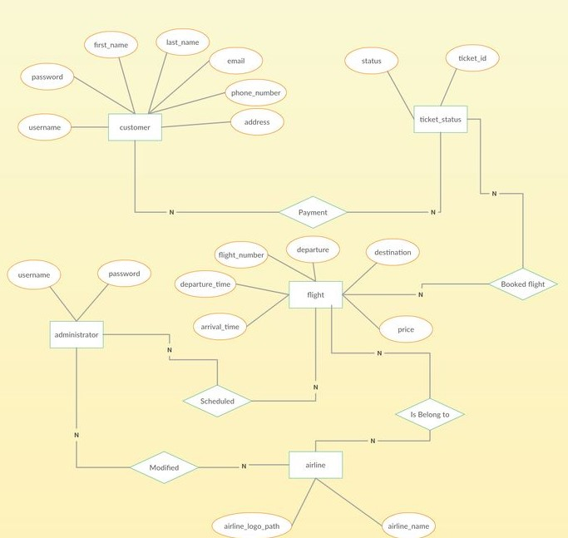
SYSTEM ARCHITECTURE

Slide 7
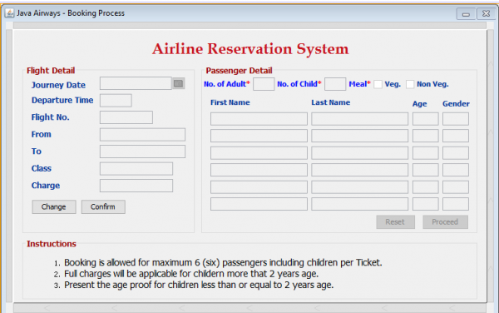

Slide 8
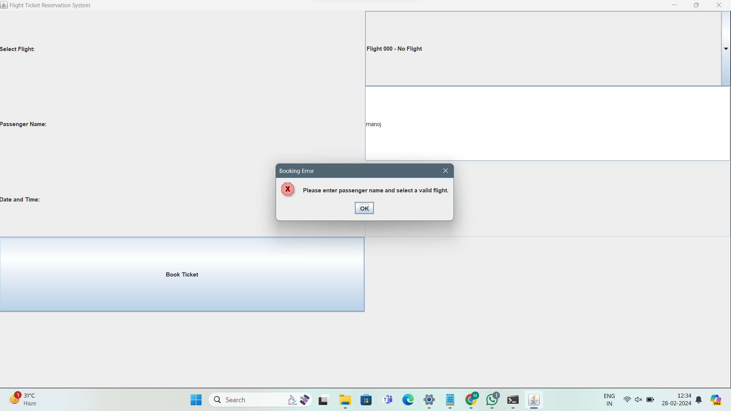
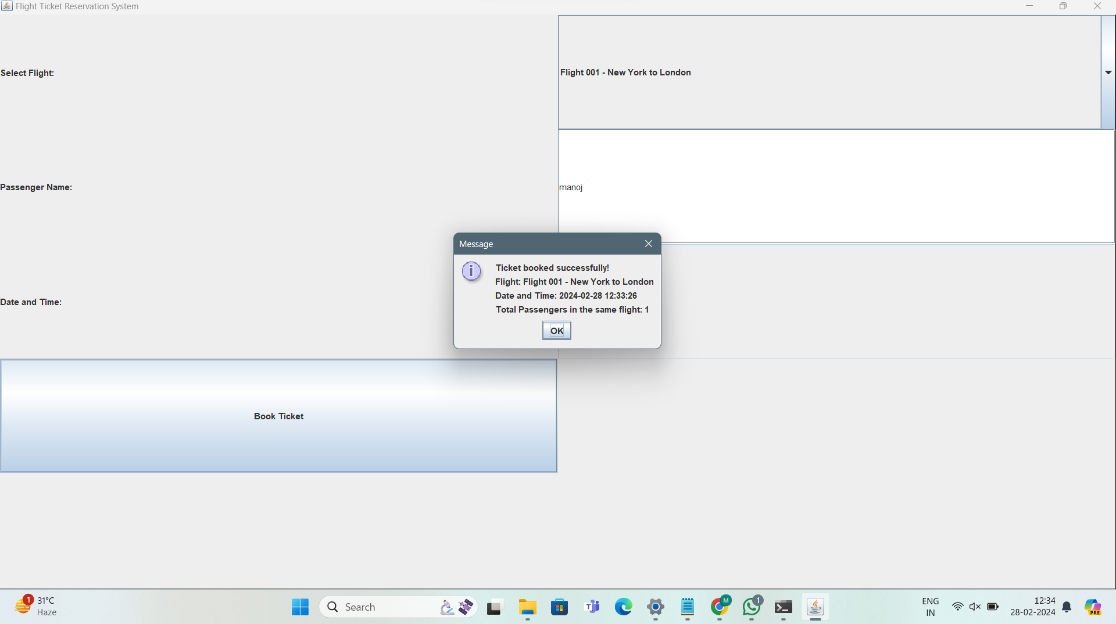
OUTPUT

Slide 9
ADVANTAGES
Enhanced User Experience: The project aims to provide travelers with a seamless and user-friendly booking experience, allowing them to search for flights, compare options, and make bookings with ease.
Comprehensive Flight Options: By integrating with airline databases through Global Distribution Systems (GDS) and APIs, the system offers users access to a wide array of flight options from various airlines worldwide, ensuring greater choice and flexibility.
Real-Time Availability Checking: Users can receive accurate and up-to-date information about flight availability, enabling them to make informed decisions and secure bookings without delays.
Secure Payment Processing: With robust encryption protocols and secure payment processing mechanisms, users can trust that their financial transactions are handled safely and securely.
Innovation and Future-Readiness: By leveraging cutting-edge technology , the project aims to set new standards for excellence in air travel booking, fostering innovation and adaptability to future trends and challenges in the industry.

Slide 10
PROPOSED MODEL
User Interface (UI): Clean and intuitive design for easy navigation.
Flight Search Engine: Advanced search functionality with real-time availability.
Fare Management System: Transparent fare display and comparison.
Reservation Management Tools: User accounts for easy access and modification.
Secure Payment Processing: Integration with secure payment gateways.
Backend System: Scalable architecture with real-time updates.
Security and Compliance: Implementation of encryption and compliance measures.
Customer Support and Feedback:Integration of customer support features and feedback mechanisms.
Continuous Improvement:Agile methodology for iterative enhancements.

Slide 11
CONCLUSION
The development of our flight reservation system represents a significant advancement in simplifying the booking process for travelers while empowering airlines and agencies with efficient tools. Through user-centric design and integration of cutting-edge technology, the system offers comprehensive flight search, real-time availability, transparent fare management, and secure payment processing.
With a focus on user experience, security, and innovation, our system aims to set new standards in air travel booking. Personalized accounts, intuitive management tools, and proactive notifications ensure a seamless experience. Moving forward, ongoing enhancements will continue to adapt to emerging trends, ensuring the system remains at the forefront of the industry, delivering convenience and reliability to travelers worldwide.

Slide 12


